Slide 1

Notes:
Introduction about face

Slide 2


DECISION MAKING 1.1
Essence of Decision Making
Sub-Topic (Example: name of college)
Notes:
Trainers,
Ask students how many of them ask their mother to cook their menu.
How many of them take some time to select dress, belt, shoes
How many of them even decide where to park their bike or car.
We are even caring about less significance objectives in our life. Are we focusing on making big decisions that will entirely change the life pattern of ourselves.
Decision making is defined as the selection of choice of one best alternative. Before making decisions all alternatives should be evaluated from which advantages and disadvantages are known. It helps to make the best decisions. It is also one of the important functions of management

Slide 3

“Your life changes the moment you make a new, congruent, and committed decision.”
—Tony Robbins
Topic/Course
Sub-Topic (Example: name of college)
Notes:
The quote conveys that “Your life is a result of the choices you make. If you don't like your life, it is time to start making better choices”.
About Tony Robbins - Anthony Jay Robbins is an American author, philanthropist, and life coach. Robbins is known for his infomercials, seminars, and self-help books including Unlimited Power and Awaken the Giant Within. In 2015 and 2016 Robbins was listed on the Worth Magazine Power 100 list.

Slide 4

AGENDA
1. Introduction – Decision Making
2. Understanding Decision Making
3. Identifying the importance of Decision Making
Notes:
We are going to cover the three important main topics
Introduction – Decision Making
Understanding the process of decision making
Identifying the importance of Decision Making

Slide 5


Decision Making.......????
Topic/Course
Sub-Topic (Example: name of college)
Notes:
Trainers, ask the students, when they are ill, people recommend them different doctors, different medicines. what do they do at that time?
As choosing a primary care doctor is one of the most important health decisions you’ll make. Now, we are not here to discuss about which doctor to choose but to discuss how wisely we can ‘decide’ (put more emphasis), whom to choose?

Slide 6
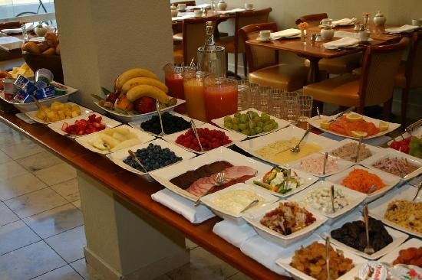
Some decisions are easy like…
Topic/Course
Sub-Topic (Example: name of college)
What to eat for breakfast?
Notes:
We have choices for food. We decide what to eat.

Slide 7

Some decisions are easy like…
Topic/Course
Sub-Topic (Example: name of college)
What to wear?
Notes:
We have choices for dresses. We decide what to wear

Slide 8

Some decisions are difficult like…
Topic/Course
Sub-Topic (Example: name of college)
Which major to choose?
Notes:
Some decisions are difficult.
Ask how many of them have made a decision of themselves to join this course.
Ask students, how many of them are confused to select particular course after +2.
Ask students, how many of them felt difficult to decide from the choices for joining a course after +2
Some decision are easy and do not require much analyzation.
Some decisions are difficult and it will take some time for us to decide.

Slide 9

Some decisions are difficult like…
Topic/Course
Sub-Topic (Example: name of college)
Choosing Friends
Notes:
It is easy to select a dish for eating.
But it is difficult to choose friends.
Some decisions are difficult.

Slide 10

In every situation you have to search for…
Topic/Course
Sub-Topic (Example: name of college)
Notes:
In every situation we have to ask our mind the important questions Who, What, Where, When, How, Why to make correct decisions.

Slide 11
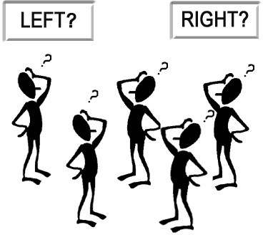
How to make right decisions?
Topic/Course
Sub-Topic (Example: name of college)
Notes:
Making right decisions in our life is the key factor in many parts of our life.
Our school life was completed decided by our parents.
But, in our college life, we have to take many decisions at many times. Tell students, that they may observe the spoon feeding from the parents and teachers have stopped after +2 and it is very important for them to take wise decisions on their career, jobs, higher studies. Now,
They have take decisions of their own from personal life to professional life.

Slide 12


Topic/Course
Sub-Topic (Example: name of college)
OR
Notes:
Trainers, ask the students which between the two desserts would they like to have? They only have one choice.
For some students it will be easy to decide because some might not like strawberry, so they’ll opt for chocolate. But tell them, for a person who likes both the desserts, it will be difficult for him to decide.

Slide 13

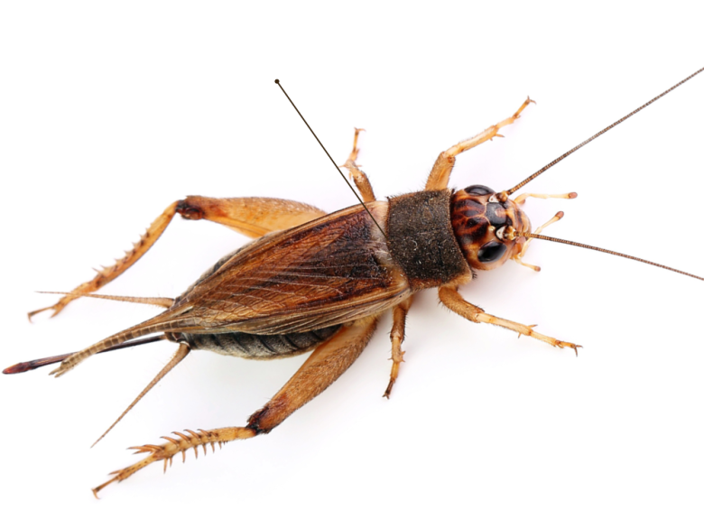
Topic/Course
Sub-Topic (Example: name of college)
OR
Notes:
Which one do you want to keep as a pet?
Obviously, they’ll opt for butterfly

Slide 14


Topic/Course
Sub-Topic (Example: name of college)
OR
Notes:
Fame or Money?

Slide 15

Decision Making Process
Topic/Course
Defining the problem
Gathering information
Developing and weighing the options
Choosing best possible alternatives
Plan and execute
Take follow up action
Review the action
Sub-Topic (Example: name of college)
Notes:
Since decision making process follows the above sequential steps, a lot of time is spent in this process. This is the case with every decision taken to solve management and administrative problems in a business setting. Though the whole process is time consuming, the result of such process in a professional organization is magnanimous.

Slide 16

Defining the problem
Topic/Course
Notes:
Trainer to explain this process of decision making
Defining the Problem. The first step in making the right decision is recognizing the problem or opportunity and deciding to address it. Determine why this decision will make a difference

Slide 17

Gather information
Topic/Course
Sub-Topic (Example: name of college)
Notes:
Trainer to explain this process of decision making
Gather information. Next, it’s time to gather information so that you can make a decision based on facts and data. This requires making a value judgment, determining what information is relevant to the decision at hand, along with how you can get it. Ask yourself what you need to know in order to make the right decision, then actively seek out anyone who needs to be involved.

Slide 18

Developing and weighing the options
Topic/Course
Sub-Topic (Example: name of college)
Notes:
Trainer to explain this process of decision making
Developing and weighing the options:
In this step, you’ll need to “evaluate for feasibility, acceptability and desirability” to know which alternative is best, according to management experts Phil Higson and Anthony Sturgess. Managers need to be able to weigh pros and cons, then select the option that has the highest chances of success. It may be helpful to seek out a trusted second opinion to gain a new perspective on the issue at hand.

Slide 19

Choosing the best possible alternatives
Topic/Course
Sub-Topic (Example: name of college)
Notes:
Trainer to explain this process of decision making
Choose the best possible alternatives. When it’s time to make your decision, be sure that you understand the risks involved with your chosen route. You may also choose a combination of alternatives now that you fully grasp all relevant information and potential risks.

Slide 20

Plan and execute
Topic/Course
Sub-Topic (Example: name of college)
Notes:
Trainer to explain this process of decision making
Plan and Execute
Plan and execute the decision taken by you after careful analysis.

Slide 21

Take follow up action
Topic/Course
Sub-Topic (Example: name of college)
Notes:
Trainer to explain this process of decision making
Take action. Next, you’ll need to take action for implementation. This involves identifying what resources are required and gaining support from employees and stakeholders. Getting others onboard with your decision is a key component of executing your plan effectively, so be prepared to address any questions or concerns that may arise.

Slide 22

Review your action
Topic/Course
Sub-Topic (Example: name of college)
Notes:
Trainer to explain this process of decision making
Review your decision. An often-overlooked but important step in the decision making process is evaluating your decision for effectiveness. Ask yourself what you did well and what can be improved next time.
“Even the most experienced business owners can learn from their mistakes … be ready to adapt your plan as necessary, or to switch to another potential solution,” Chron Small Business explains. If you find your decision didn’t work out the way you planned, you may want to revisit some of the previous steps to identify a better choice.

Slide 23
Example
Topic/Course
Amy really wants a new cell. Unfortunately, the one she wants costs Rs. 15000, and she has only Rs. 10000. She wonders how she will get the rest of money?
Sub-Topic (Example: name of college)
Notes:
An example to make students understand decision making.

Slide 24

Step 1: Relax
Topic/Course
Sub-Topic (Example: name of college)
Take a deep breath and let all of the air out
Notes:
Trainer to explain
The first step in decision making is to get relaxed

Slide 25

Step 1: Relax
Topic/Course
Sub-Topic (Example: name of college)
The first thing Amy should do is relax
Notes:
Amy should relax to make good decisions

Slide 26

Step 2: Say something positive....I can do this...I can deal with this...
Topic/Course
Sub-Topic (Example: name of college)
This gives you confidence and makes you feel good about yourself
Notes:
Being positive gives us the confidence and make us feel good about ourselves

Slide 27

Step 2: Say something positive
Topic/Course
Sub-Topic (Example: name of college)
Now its time for Amy to give herself confidence
Notes:
Amy gains confidence by saying the positive words “I think I can”

Slide 28

Step 3: Identify the problem
Topic/Course
Sub-Topic (Example: name of college)
Try to search out actual problem
Notes:
Identify the problem to be solved

Slide 29

Step 3: Identify the problem
Topic/Course
Sub-Topic (Example: name of college)
Amy does not have enough money to buy the
phone
Notes:
Amy identified the problem. She does not have money to buy the phone

Slide 30

Step 4: What are your choices?
Topic/Course
Sub-Topic (Example: name of college)
Think of all the possible solutions
Notes:
A problem may have one or many solutions

Slide 31
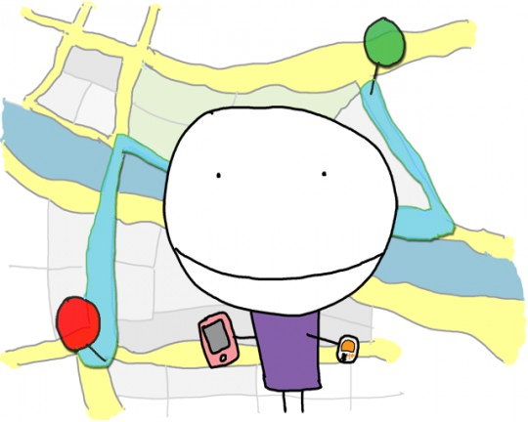
Step 4: What are your choices?
Topic/Course
Sub-Topic (Example: name of college)
Come up with list of possible solutions:
Save her money until she’s has got enough money.
Borrow money from her parents or friends.
Buy a cheaper phone.
Notes:
Amy has 3 choices.
.

Slide 32

Step 5: Consider the consequences of your solutions
Topic/Course
Sub-Topic (Example: name of college)
List both the negative and positive consequences
Notes:
Consider all the solutions

Slide 33

Step 5: Consider the consequences of your solutions
Topic/Course
Sub-Topic (Example: name of college)
1) Save her money until she’s has got enough money.
+VE: She will feel proud about her accomplishments; she will get the phone she really wants.
-VE : She has to wait.
Notes:
Amy has 3 choices.
I choice
1. Save her money until she has got enough money to buy the phone.

Slide 34

Step 5: Consider the consequences of your solutions
Topic/Course
Sub-Topic (Example: name of college)
2) Borrow money from her parents or friends.
+VE: Amy will get the phone right away.
-VE: She won’t feel independent; friends or parents might say “NO” to her.
Notes:
II choice
Borrow money from her parents or friends

Slide 35

Step 5: Consider the consequences of your solutions
Topic/Course
Sub-Topic (Example: name of college)
3) Buy a cheaper phone
+VE : Amy will get the phone right away.
-VE : Amy won’t get the phone the phone she really wants.
Notes:
III choice
Buy a cheaper phone

Slide 36


Step 6: What is important to you???
Topic/Course
Sub-Topic (Example: name of college)
Notes:
Among the above choices, what is important

Slide 37

Step 6: What is important to you???
Topic/Course
Sub-Topic (Example: name of college)
What is important for Amy??
....getting the phone she really wants???
.... getting the phone right away???
....not borrowing money???
After choosing what is important, cross out other solutions.
Notes:
What is important to Amy

Slide 38

Step 7: Make the decision
Topic/Course
Sub-Topic (Example: name of college)
Notes:
It is time to take correct decision

Slide 39

Step 7: Make the decision
Topic/Course
Sub-Topic (Example: name of college)
Amy decided to wait in order to save some more money for phone.
Notes:
So, we can understand that when we take a decision, we sometimes have to sacrifice or compensate some other thing. In this case, Amy has to wait to get a phone that she wants.
[For trainers reference – this example was simply to understand decision making, so kindly tell the students that this is one of the methods that is considered for taking a decision. In the upcoming slides we will look into better methods.]

Slide 40


Decision Making in
Management Process
Solve problems
Tackling the situations
Handling crises
Resolving conflicts
Notes:
Decision Making is the essence of the management process. Decisions are made to solve problems, tackling the situations, handling crises and resolving conflicts that are inevitable. Decision Making is at the core of planning. The Concept of decision making involves defining the problem, finding, comparing and choosing a course of action. It is a process or activity of choosing an appropriate course of action from several alternative courses.
The term “decision making” has been defined as a process of judging various available options and narrowing down choices to a situation one. Decision making is a conscious and human process involving both individual and social phenomena based on factual and value premises which concludes with a choice of one behavioral activity from among one or more alternatives with the intention of moving towards a desired state of affairs.”

Slide 41
Activity
Describe the most difficult decision that you had to
make and why was it so difficult.
Provide a situation when a decision you made affected others
How do you come to conclusions?
Provide an example of a bad decision that you made
and explain what made it a poor decision.
Do you find making decisions difficult?
Notes:
Activity:
Total 15 minutes:
For 1 question 3 minutes. (conduct a brainstorm and get the responses)
Ask the 1st question and get the responses.
Continue up to 5th question
Ask questions to the students who have not answered. Give chances to the students randomly and get the responses

Slide 42


THANK YOU
Notes:
Trainer to Thank the Students saying that it was a good session and re- iterate the usefulness of the session.

